Slide 1
TED Predictions
Text regression on ted transcripts
Nathan walker

Slide 2

Overview
Project Motivation:
What is the problem?
What data exists?
What is the proposed solution?
Project Details:
Data Overview
Data Cleaning
Exploratory Data Analysis
Modeling
Results
Conclusion

Slide 3
Project Motivation
What is the problem?
TED Talk videos are not always well-received by the online audience, which hurts the TED brand.
What data exists?
TED has access to user ratings, video transcripts, and video metadata.
What is the proposed solution?
Create a model to predict user ratings for new videos and only publish the best talks.
What is the proposed metric for success?
Percent of positive user ratings
User Ratings:
Positive:
Beautiful, courageous, fascinating, funny, informative, ingenious, inspiring, jaw-dropping, persuasive
Negative:
Confusing, long-winded, obnoxious, OK, unconvincing

Slide 4
Data Overview
Metadata for 2550 Videos
Transcripts for 2467 videos
Talk Duration
Number of Main Speakers
Name of TED Event
User Rating Counts
'Thank you. I have to tell you I\'m both challenged and excited. My excitement is: I get a chance to give something back. My challenge is: the shortest seminar I usually do is 50 hours.(Laughter)I\'m not exaggerating. I do weekends — I do more, obviously, I also coach people — but I\'m into immersion, because how did you learn language? …

Slide 5
Data Cleaning: Metadata
Creating Event Categories
355 events represented
Can be slimmed down to 8 categories:
TED Yearly: 978
TEDx: 471
TED Global: 464
TED@: 141
TED Women: 96
TED Salon: 79
TEDMED: 68
Other (<50 events): 158
Excluded 95 non-TED talks

Slide 6
Data Cleaning: Transcripts
Text Normalization:
Remove \
Add missing spaces
Remove non-speaking interaction between parentheses
Non-Speaking Interaction Counts:
Laughter: 9,975
Applause: 5,375
Music: 600
Numeric Representation of Text:
GloVe Vectors (128 dimensions)
'Thank you. I have to tell you I\'m both challenged and excited. My excitement is: I get a chance to give something back. My challenge is: the shortest seminar I usually do is 50 hours.(Laughter)I\'m not exaggerating. I do weekends — I do more, obviously, I also coach people — but I\'m into immersion, because how did you learn language? …

Slide 7
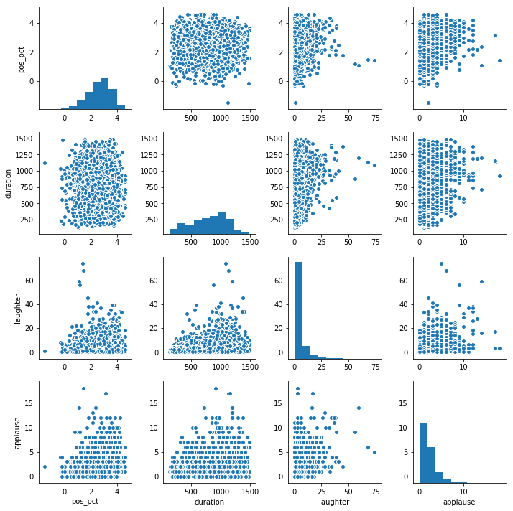
Exploratory Data Analysis
Major Takeaways:
Most of the Positive% data is above 75% positive
Most videos have no “Laughter” or “Applause”
No patterns or strong correlation among predictor variables
No patterns or strong correlation between Positive% and any predictors

Slide 8
Modeling
Train and Test Split
70/30
LASSO Regression
Variable selection and fitting
10-fold Cross-Validation
Avoid over-fitting
Models:
Intercept Only
Metadata Only
Word Vectors Only
Overall Best

Slide 9
Results: RMSE
RMSE for Test Data:
Intercept: 0.8744
Metadata: 0.8432
Word Vectors: 0.7894
Overall Best: 0.7678
RMSE Comparison against Intercept:
Metadata: 3.7% better
Word Vectors: 10.8% better
Overall Best: 13.9% better

Slide 10
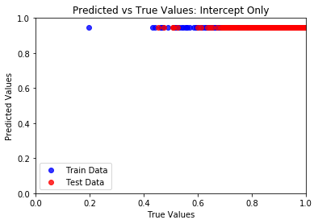
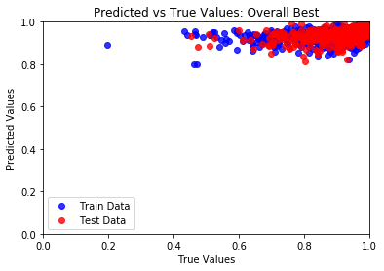
Results: Predicted vs True Values
Intercept Only model
Best overall model: 14% better

Slide 11
Conclusion
Major Takeaways:
A 14% improvement in RMSE is “better,” but not good
Not enough data to predict scores under 80%
Next Steps:
Gather more data from YouTube’s API
Use thumbs-up/-down as “success” metric
Consider Doc2Vec or tf-idf for text encoding

